Slide 1
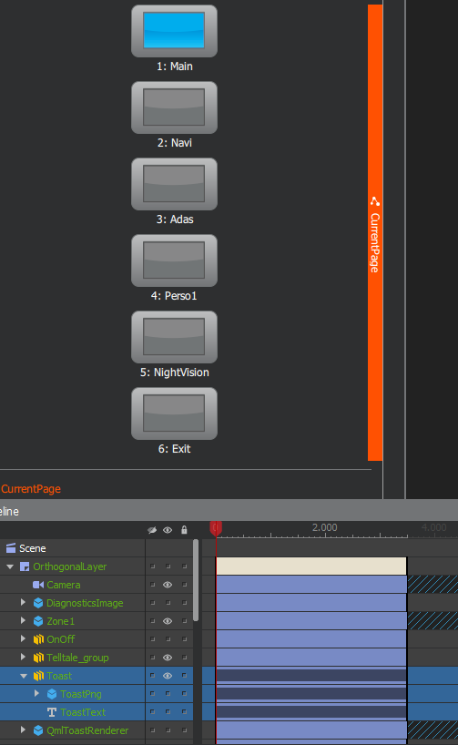
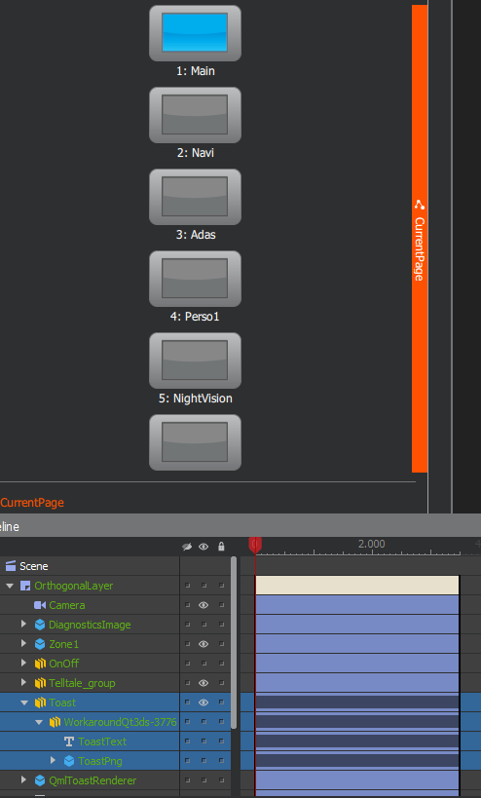
Initial presentation
Developer A
Presentation after changes
Changes:
1. The timeline has been fixed on some slides
2. The content of the “Toast” group was combined into “WorkaroundQt3ds-3776” group.
1
2

Slide 2
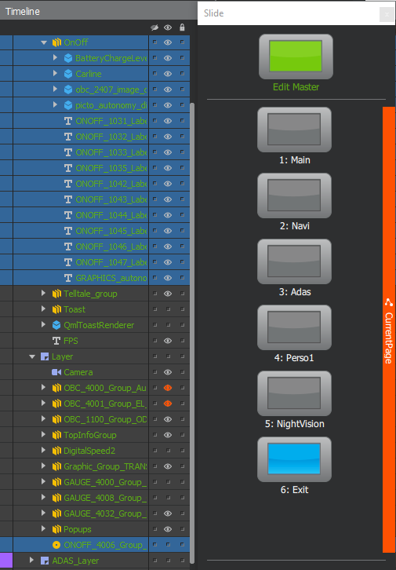
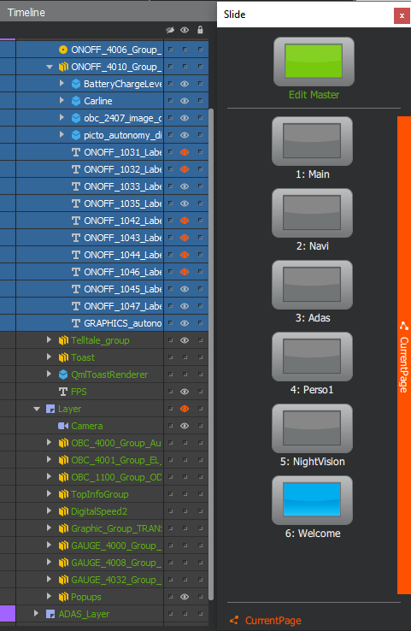
Initial presentation
Developer B
Presentation after changes
Changes:
1. Exit slide has been renamed to Welcome
2. OnOff group has been renamed to ONOFF_4010_Group… and moved to Welcome slide
3. ONOFF_4006_... Component has been moved to Welcome slide
2
3
1
Welcome

Slide 3

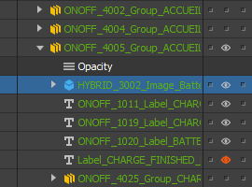
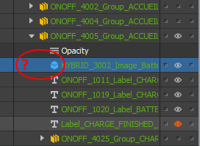
Developer A:
git push origin master
Result
Before conflict
After conflict
Developer B:
git pull –rebase origin master
*got a merge conflict*
*resolved merge conflict using e.g. «source tree» tool*
git rebase --continue
e.g. after the merge, you can see a case that cannot be repeated from the Qt3DStudio UI: there is no material in the HYBRID_3002_Image_BatteryChargeLevel rectangle
As a result, it doesn’t work
Some elements are lost or don’t work correctly (*) if we use this “merge” method, and It is necessary to check correctly working of each element from presentation and developer will lose a lot of time.
Therefore, developers must resolve merge conflicts as follows:
The developer applies his changes to the presentation from master branch manually.
(*)-In addition to the described problem, many different problems were discovered, for example: after resolving the conflict, some elements are displayed in the QT3DS editor but not displayed in the application, or some elements completely disappear from the presentation (although at first glance they are present in xml), etc.

