Slide 1
Target user needs from Project Artboard
UI / UX designers and developers

Slide 2
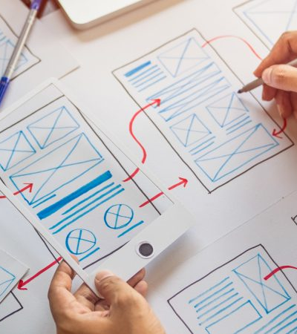
UX/UI designer
Creative problem solver with user first approach. Is excited about creating innovative, user friendly and beautifully crafted digital experiences. Natural way of working is through experimenting, sharing ideas rapidly, and improving based on feedback. Works mainly with visual tools. May or may not have coding skills. Designer’s core responsibility is to make sure that the design is creating real value, is understood by users and is easy to use. Usually, this happens before actual development of the app or feature can start.

Slide 3

GUI developer
Creative problem solver with technical mindset. Is excited about creating innovative and beautifully working digital experiences. Natural way of working is to split the projects into small ’bite size’ chunks to be develop, tested and released. Works mainly with code editor(s). Developers core responsibility is to design, create, test and maintain a functioning software that provides value for users. SW development work usually starts after the design of the app or feature has been defined.

Slide 4
Designer – developer: shared needs for improved collaboration

Slide 5
GUI developer
UI / UX Designer
“What I design is what I get. No one needs to code it for me.”
“How might we allow developer to be in the process from the beginning?”
Run workshops, collect requirements and understand briefs
Ideate, sketch, create designs and prototypes
Conduct user tests
Design with collaborative tools to review and iterate the work with other team members
Maintain and use company wide design system
Create designs for multiple platforms and devices
See and test designs in a real device fast
Communicate the design intent to developers and back
Get support from technical experts to iterate the design
Keep design “open” for changes as long as possible
Maintain ownership of the product / feature = control the process from vision to reality
Understand the context, user needs and design of the app or feature
Communicate with designers and read design specifications
Split the designs into smaller, 'bite size' chunks to be developed
Write front-end code to create a working solution based on specifications
(Preferably) use same components with designers
See end results fast
Review the developed versions with designers and other stakeholders
Make sure, the design works in different target platforms, screen sizes
Write automated tests, or communicate with testers
Debug & fix bugs
Work with third party libraries
Set up environment
Select suitable tech stack
Write & read user stories

Slide 6
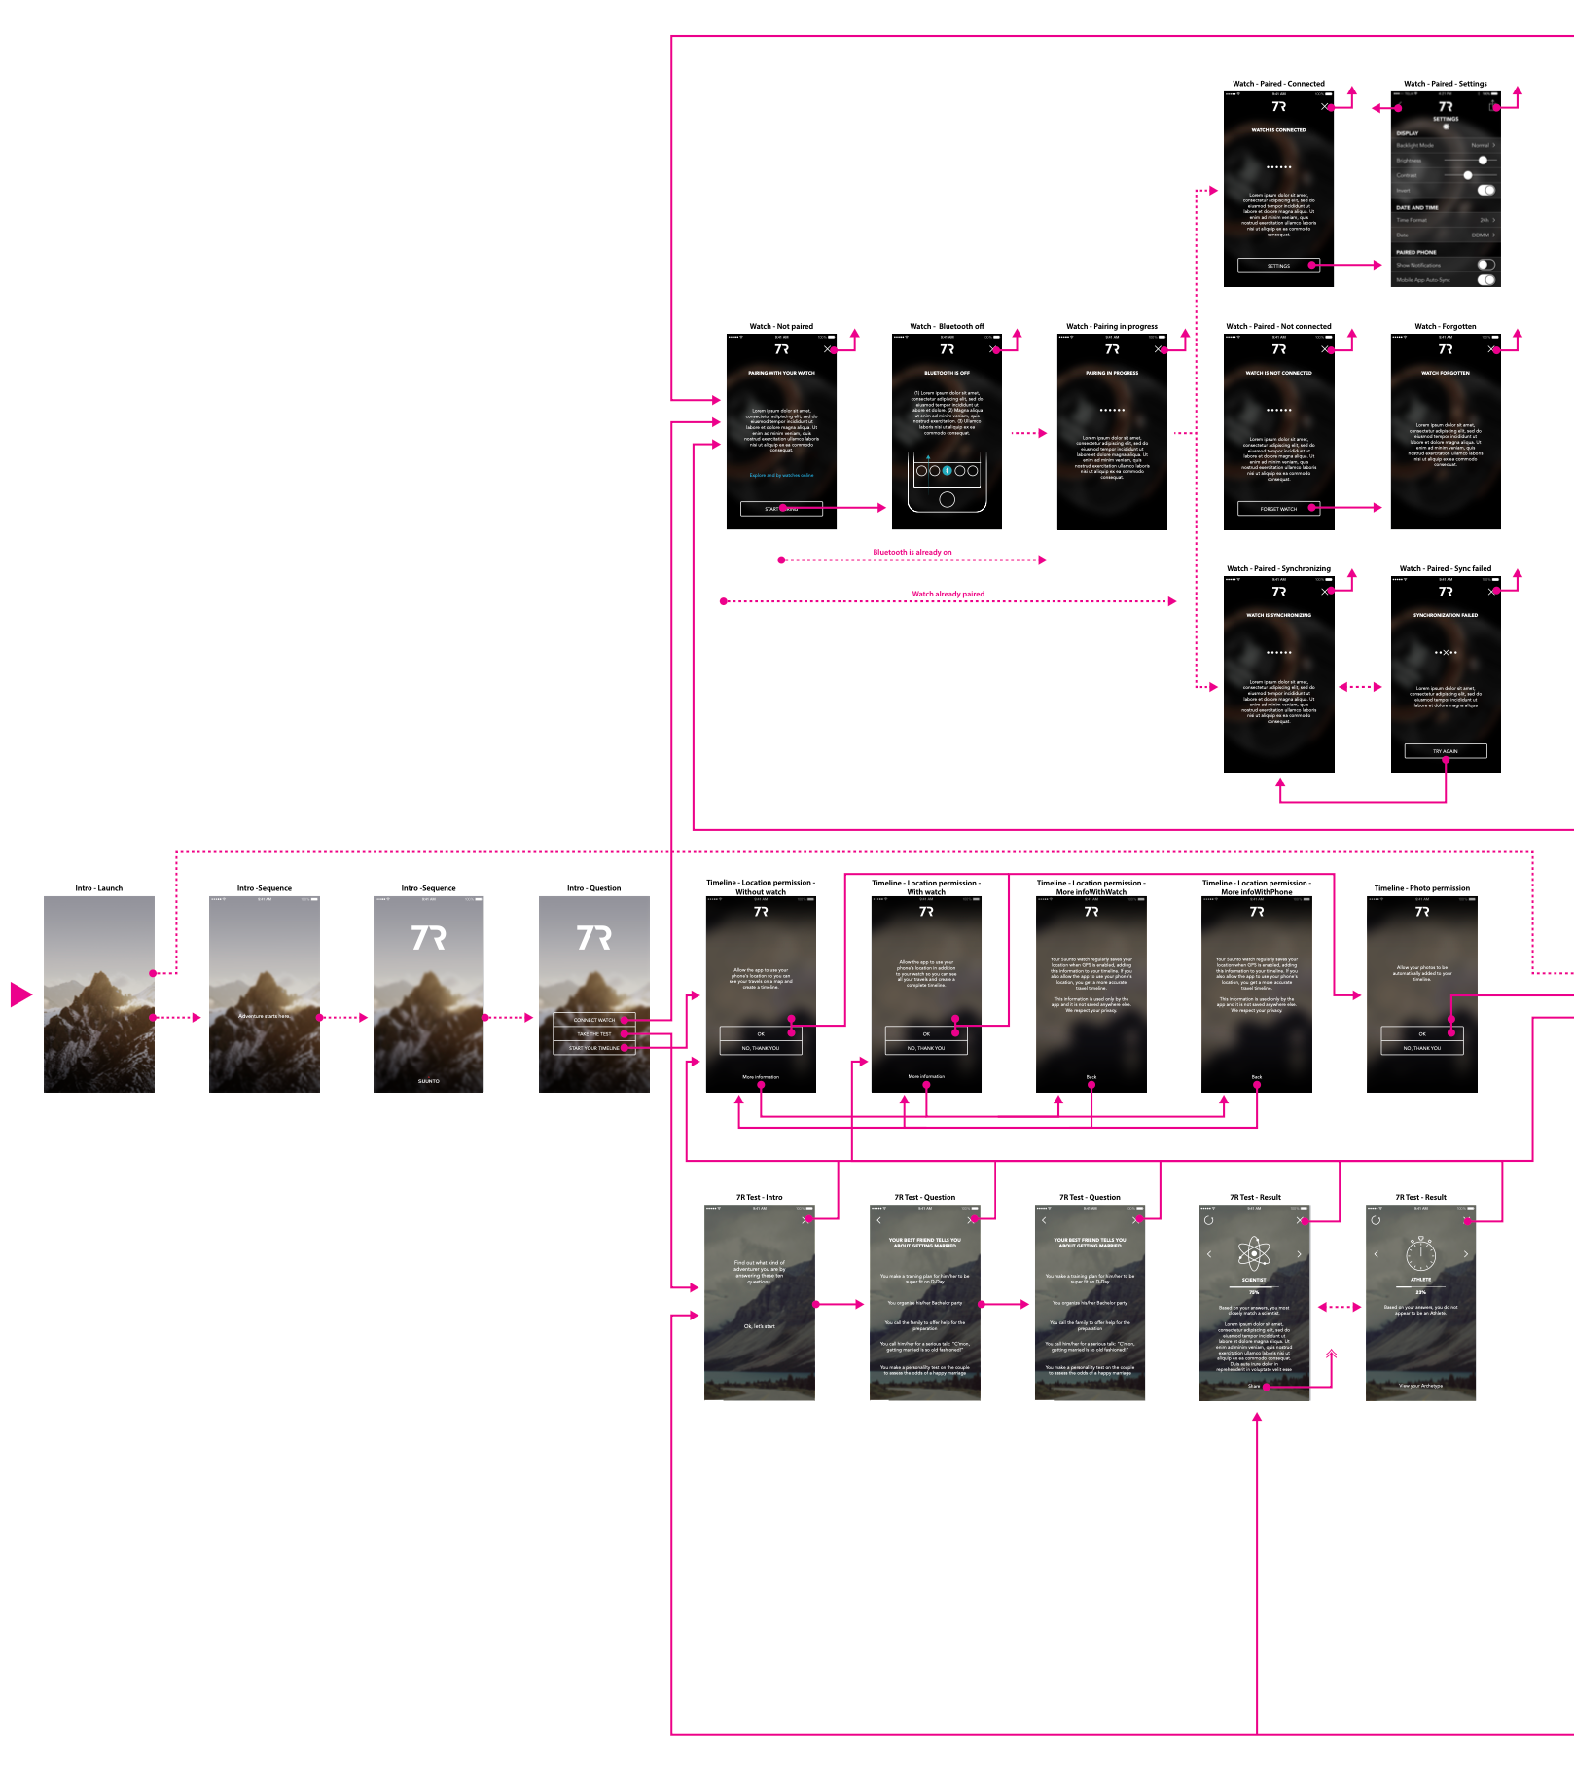
Handoff
In standard app creation process, the design handoff to developers takes place after design is done. Often, this requires lengthy discussions with developers to get the design intent clarified and creating extensive written and visual design specifications.
In most cases, the design specifications remain only half baked from developers' point of view. Developers are struggling to understand what the design intent is, because the design specifications are too hard to interpret, there are potential technical constraints, designer has been using a lot of poorly defined custom components or some critical edge cases are not covered at all.
Traditionally, from this point onwards it is developers' task to bring the design into life. After this, designer is not an active participant of the actual app creation process. In best cases, they may act as a reviewer of the implementation before features get published. This way, designers lose control of participating the process and ability to help developers. On the other hand, developers are forced to solve the issues either by themselves or constantly resend the work back to designer's table.

Slide 7
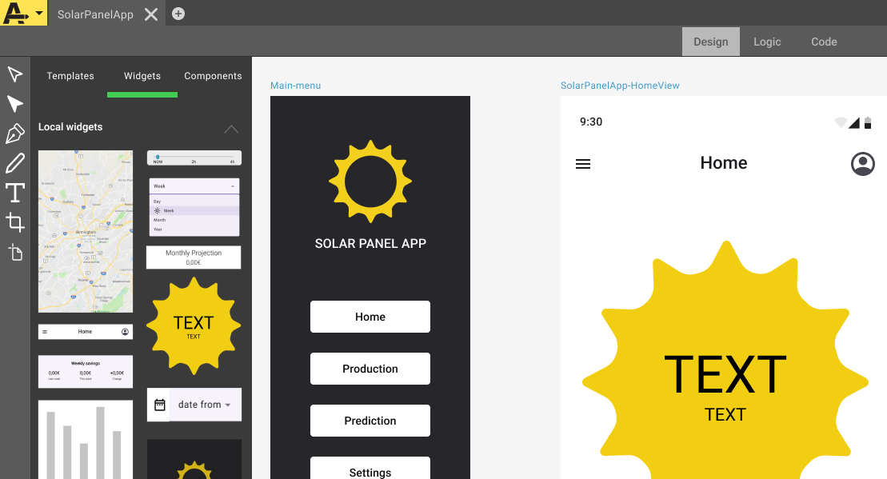
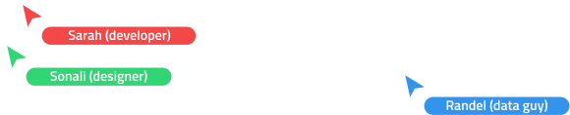
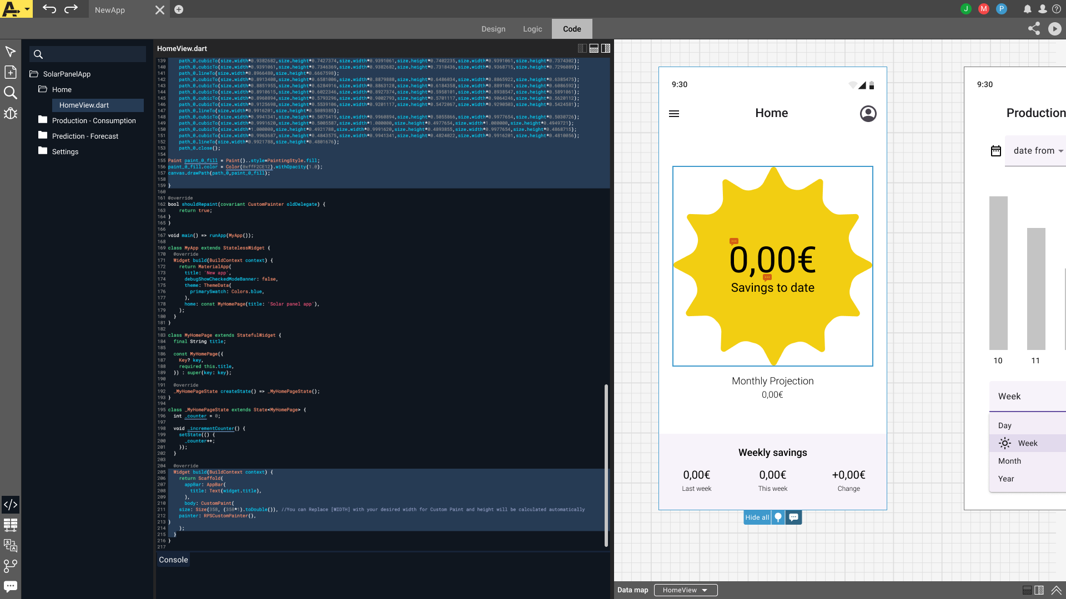
User problem worth solving
Designers are often working without understanding the SW framework or they don’t have access to it. Developers may have difficulties to understand the design intent or get involved to the design process.
In other words, they are not able to collaborate through out the critical phases of app creation process.
Black box

Slide 8
Artboard: Solution

Slide 9
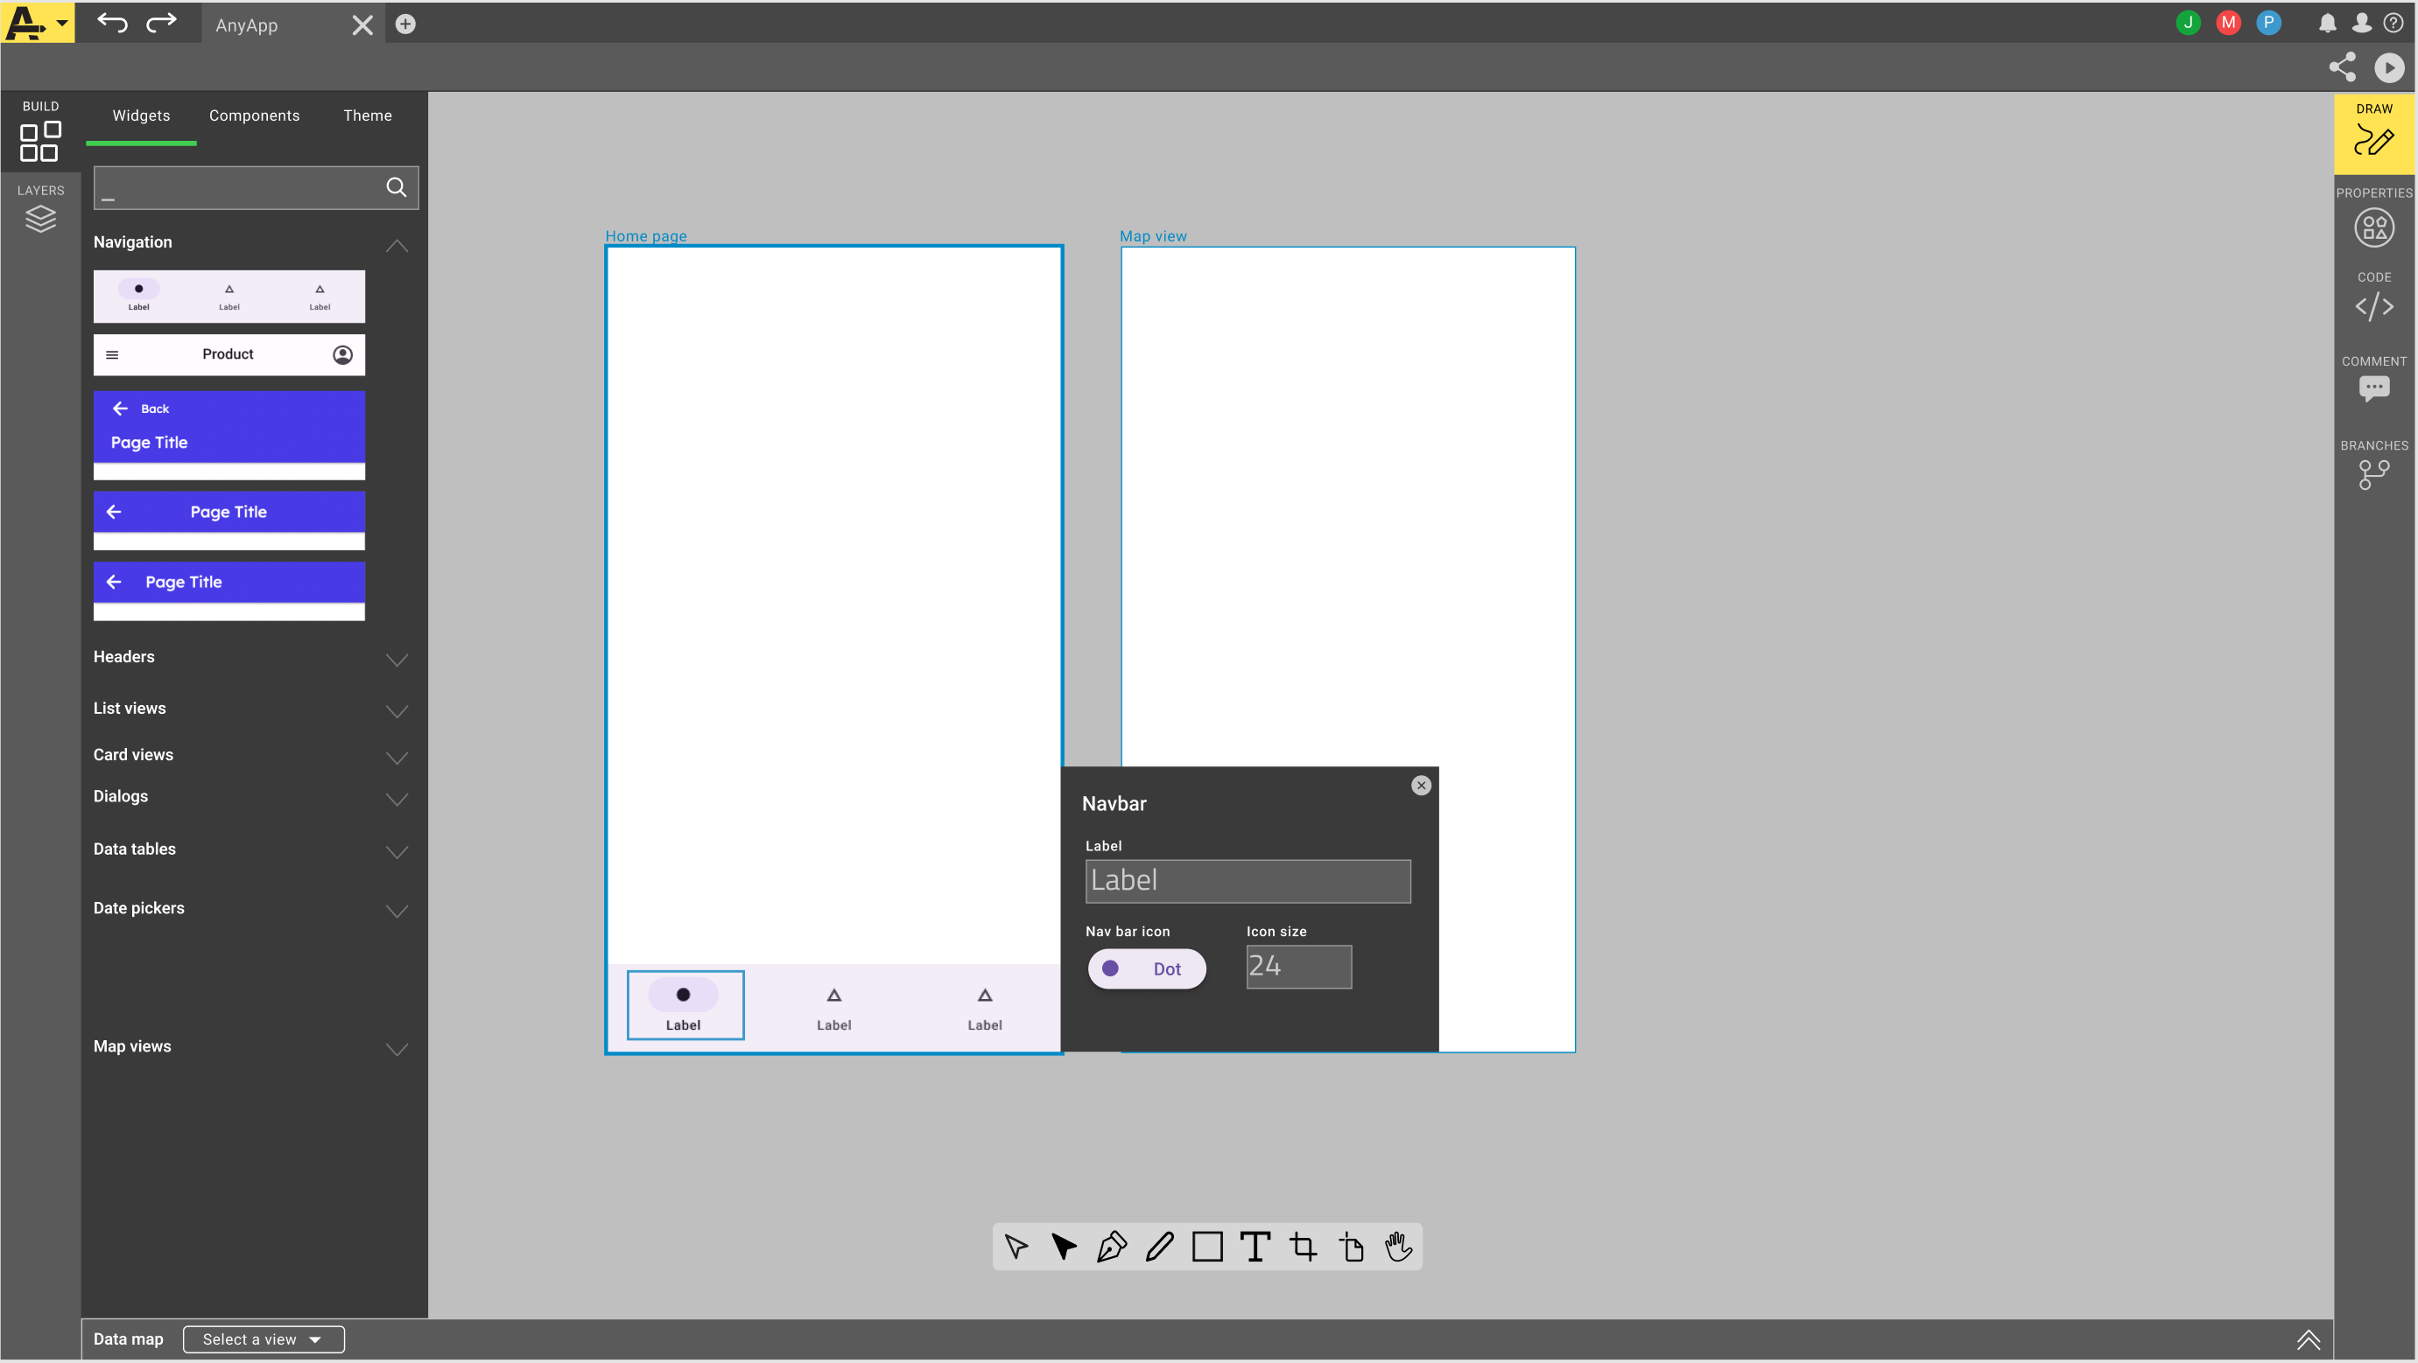
Concept idea
Artboard is a cloud-based app creation software where designers and developers can collaborate to create apps together with tools that they are both familiar with. Users get to see the design visually and in code.
Designers can transform designs into code visually in a context where they understand the SW framework even without coding skills. Developers without visual design skills get to participate to the design process.
Users can review the work together with live preview and see what is working or not.
Solve problems together with collaborative manner from day 1.

Slide 10
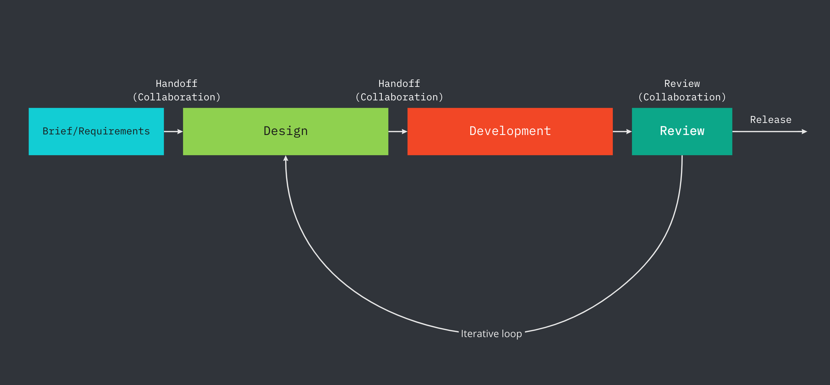
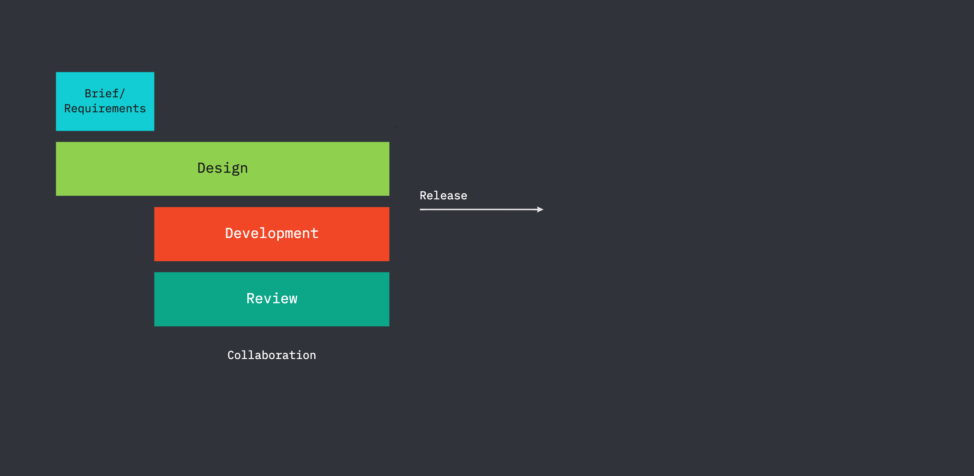
Benefits
Current paradigm
What previously took 6 weeks to finish can be done in a fraction of time with Artboard.
Product teams can move directly from ideation to development with Artboard. From the point when the ’traditional design prototype’ is done, the solution is already running on code.
Artboard supports the idea of having “single source of truth” when design and code are in one place and always up to date. This ensures consistency throughout the creation process, reduces risk of miscommunication and allows access for several stakeholders to be involved without complex handoffs. Results can be reviewed and and verified in real time.
Artboard model

Slide 11
For UX/UI designers
Use infinite canvas to create and view your app. Leave comments and annotations next to the app views.
Design from scratch or use ready made widgets to create programmatical components instead of delivering plain vector graphics and layouts
Designer friendly tools to produce UX flows with code ready interactions, transitions and animations
Visual tools to set and manage data mapping to UI widgets and components
Create custom experiences, UI elements or add functions together with developers
Live preview the design in real time
Run the design in real device during design process
Single source of truth. Design and code is one place. Always up to date

Slide 12
For GUI developers
Infinite canvas: See the whole app design in one context
Maximize the minimum effort of coding by reusing widgets, components and templates with designers
Use the shared components to make alternative designs proposals
Single source of truth. Design and code is one place. Always up to date
Design is the same as code: No need to try interpreting what the design specification is trying to say
Collaborate with designers to solve all edge cases together
Create custom experiences, UI elements or add functions
Get ready solution to your own IDE and modify and push back
Deploy

Slide 13
Target customers
Individual entrepreneurs
Get the ideas produced fast based on given briefs from clients. You can create and publish simple apps with minimum resources alone.
Small companies and start-up’s
Go from ideation to development fast. Save time and resources. Design and code in one shared tool allows you to maintain your app and scale up when time is right.
Enterprises
Get started with new initiatives fast. Build new concepts and test, if your app or project has market fit. While exploring, you get a production ready code, which you can integrate to your existing systems.

