Slide 1
Open solution
Notification of existing Qt projects with outdated format
Outdated Qt projects marked in the Solution Explorer
Right-click solution → Qt → Update project format
  ⇒ Solution update dialog
Right-click outdated project → Qt → Update project format
  ⇒ Project update dialog for the selected project
Qt Visual Studio Tools – Some projects have outdated formats. Update
Solution
Project1
Project2
…
ProjectN
Qt
Update project format
…
…
[Solution Context Menu]
…
..
R
Solution update dialog
Solution
Project1
Project2
…
ProjectN
Qt
Update project format
…
…
[Project Context Menu]
…
..
R
Project update dialog

Slide 2
Update solution
List of outdated projects
  Label: project name
  Drop-down: update option
    Auto (default), Manual, Skip
Press All Auto, All Manual or Skip All
  ⇒ Options for all list entries are set to Auto, Manual or Skip, resp.
Select list entry
  ⇒ summary of incompatibilities
Select entry with the Skip option
  ⇒ Update button is disabled
Press Update or Update All
  ⇒ Update selected project or all projects, resp.
Press Close
  ⇒ dialog is closed
Update Qt Projects
All Auto
All Manual
All Skip
Project | Update
Project 1 | Auto
Project 2 | Skip
Project 3 | Manual
…
Project N | Auto
Project 3 – Summary of incompatibilities
…
…
…
…
Update
Update All
Close

Slide 3
Update solution projects
Solution update dialog opened
Select entry with “Auto” → Update
  ⇒ Confirmation message box
  If Yes ⇒ project is updated
  ⇒ Message box with result
  If update is successful ⇒ remove project entry from list
  If list is empty ⇒ close the solution update dialog
Select entry with “Manual” → Update
  ⇒ Project update dialog
Press Update All
  ⇒ Confirmation message box
  If Yes ⇒ all projects are updated according to the selected option
  ⇒ Show results
Update
Update All
ToUpdate
= { Selected project }
ToUpdate
= All projects
ToUpdate
is empty?
Yes
No
NextProject
= POP(ToUpdate)
NextProject
is “Skip”?
Yes
No
Yes
NextProject
is “Auto”?
No
Update NextProject
Show project update dialog
Show result

Slide 4
Update project
Side-by-side view
  Project rules (tools/item groups) and associated items
  Left is current, right is conversion result
Press a rule or item on either side
  ⇒ Table of properties/metadata, and corresponding values
Select config from drop-down list
  ⇒ Data for the selected config
Press XML
  ⇒ Project XML view
Press Convert
  Conversion is applied to this project
  Process continues for the next project, if any
Press Skip
  Conversion is skipped for this project
  Process continues for the next project, if any
Press Cancel
  Conversion cancelled for all projects
  All changes are rolled back
Project 3 – Update project format
Debug|x64
ClCompile
CustomBuild
Link
MyClass.cpp
Main.cpp
MyClass.h
QtSettings
QtMoc
MyClass.h
MyClass.cpp
ClCompile
Main.cpp
Link
Property | Value
… | …
Property | Value
… | …
Properties
XML
Convert
Skip
Cancel

Slide 5
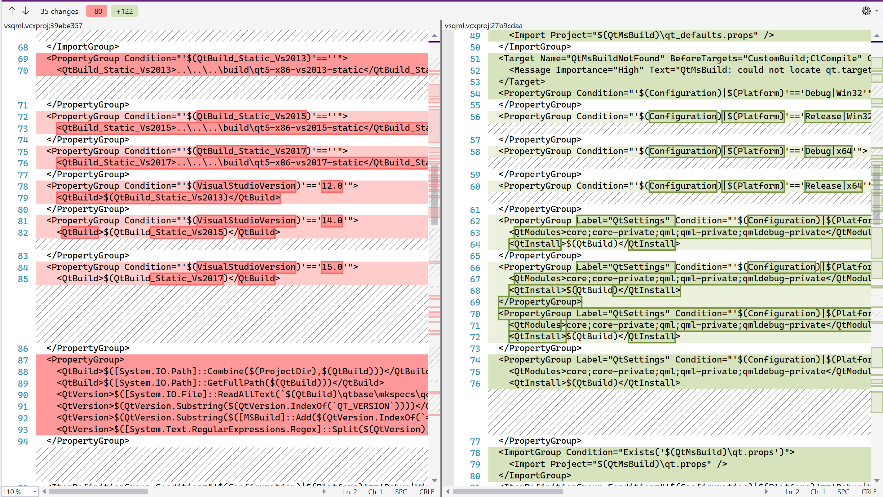
Project XML view
Side-by-side diff view
  Project XML
  Left is current, right is conversion result
Press Properties
  ⇒ Project properties view
Press Convert
  Conversion is applied to this project
  Process continues for the next project, if any
Press Skip
  Conversion is skipped for this project
  Process continues for the next project, if any
Press Cancel
  Conversion cancelled for all projects
  All changes are rolled back
Project 3 – Update project format
Properties
XML
Convert
Skip
Cancel

