Slide 1
Qt Gemini
Qt Creator UI WORKFLOW - Guideline

Slide 2
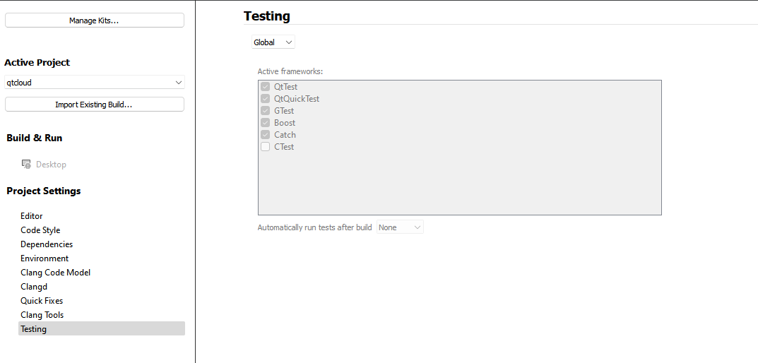
Starting point – project settings
We create an additional section in project settings and call it Qt CI.
Subsequent slides would suggest a UX for the whole thing.
Qt CI

Slide 3
Qt CI – settings / not git or gitlab project
Qt CI Settings
Unsupported project
To qualify for using Qt CI, your project should meet the following criteria:
Use GIT as source control
Hosted on Gitlab (private or public)
CI

Slide 4
Qt CI – settings / when not configured
Qt CI Settings
Qt CI helps you manage your project’s workflow including managing source code control (GIT) and CI (Gitlab). Your project is compatible – but has not been configured to use Qt CI.
You will need the following info to get started:
Project Gitlab URL
Project path on Gitlab
Gitlab private token
Path where this project is cloned
NGROK authentication token (why ngrok?)
We can try to auto-detect most of the information. Once configured, we will open a secure ngrok tunnel on your machine that listens to events from your Gitlab. Read more.
Press “Configure” to continue.
Qt CI

Slide 5
Qt CI – settings / config screen 01
Qt CI Settings
NOTE: Test should do the following:
Create python venv
Install relevant bindings to that venv
Check that we can access gitlab
Check that we can create ngrok token
Step 01 of 02.
Based on your project’s Git Config, we have autodetected the following, please edit if they are not correct. We are unable to automatically fetch your Gitlab token and NGROK token. Please fetch them manually and enter in the form below. Once done, click “TEST”
Key | Value
Gitlab URL | https://git.qt.io
Gitlab project path | playground/qtcloud
Clone location | C:\\Projects\\QtCloud
Gitlab token | <click to obtain or learn how>
NGROK token | <click to obtain or learn how>
Qt CI
TEST
SAVE

Slide 6
Qt CI – settings / config screen 02
Qt CI Settings
NOTE: Save the ENV file
Store .env file in the qt creator folder where scripts are located.
Start server should then execute “python run.py” to run the server.
Step 02 of 02.
Everything looks good.
Access Gitlab via REST API – OK
Identify your project and obtain project ID – OK
Able to create webhook on your project – OK
Able to create a NGROK tunnel – OK
Do you want to start this CI server every time you open this project?
[ ] Yes [ ] No
Qt CI
SAVE
Start server now

Slide 7
Qt CI – settings / configured, not running
Qt CI Settings
Server is configured but not running.
Do you want to start this CI server every time you open this project?
[ ] Yes [ ] No
Start server now
Edit configuration
SAVE
Qt CI

Slide 8
Qt CI – settings / configured, running
Qt CI Settings
NOTE:
View logs should show logs from the process “python run.py”
Server is configured and running.
Or visit http://localhost:8086
View dashboard
View logs
Stop server
Edit configuration
Qt CI

Slide 9
